Slide 1
University Of Diyala
College Of Engineering
Computer Engineering Department
Modeling Sequential Logic in VHDL
Dr. Yasir Amer Abbas
Third stage
2017

Slide 2
In this lecture
Synchronous sequential logic circuits rely on storage elements for their operations.
Flips-flops (FFs) and latches are two commonly used one-bit elements.
Others as registers, shift registers, and counters.
Only synchronous sequential logic is considered.

Slide 3
LATCHES & FLIP-FLOPS
A latch is a level-sensitive memory device (transparent).
As long as the pulse remains at the active high level, any changes in the data input will change the state of the latch.
A flip-flop (FF) is an edge-triggered memory device.
An edge-triggered FF ignores the pulse while it is at a constant level (non-transparent).
Triggers only during a transition of the clock signal.
Could on the positive edge of the clock (posedge), or negative edge (negedge).

Slide 4
Simple Latch
library ieee ;
use ieee.std_logic_1164.all;
entity D_latch is
port(
data_in: in std_logic;
enable: in std_logic;
data_out: out std_logic );
end D_latch;
architecture behv of D_latch is
begin -- compare this to D flipflop
process(data_in, enable)
begin
if (enable='1') then -- no clock signal here
data_out <= data_in;
end if;
end process;
end behv;

Slide 5
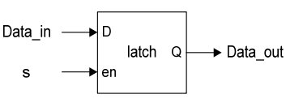
D Latch
⋅ A latch is inferred because the IF statement is incomplete.
⋅ The notion of implied memory is instantiated in this case.
…
always @(S or Data_In)
if ( S )
Data_out = Data_In;
…..

Slide 6
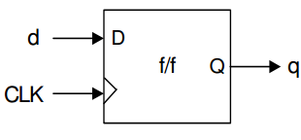
Basic positive-edge triggered D flip-flop:
module ff (clk, d, q) ;
input clk, d ;
output q ;
reg q ;
always @(posedge clk)
q <= d ;
endmodule

Slide 8
A non-blocking assignment ( <=) is called concurrent procedural assignments.
Allows scheduling of assignments without blocking execution of the statements that follow.
module shiftregx (a, b, c, d, clk) ;
input d, clk ;
output a, b, c;
reg a, b, c ;
always @(posedge clk)
begin
a <= b ;
b <= c ;
c <= d ;
end
endmodule
Module shiftregY (A, B, C, D, clk) ;
input D, clk ;
output A, B, C;
reg A, B, C;
always @(posedge clk)
begin
C <= D ;
B <= C ;
A <= B ;
end
endmodule

Slide 9
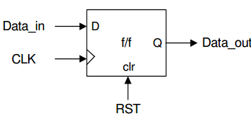
Example : D flip-flop with asynchronous reset.
Module FF2 (CLK, Data_in, RST, Data_out);
Input CLK, Data_in, RST;
output Data_out;
reg Data_out;
always @(posedge RST or posedgeCLK)
if( RST ) Data_out <= 0 ;
else Data_out <= Data_in ;
endmodule
Exercise: Modify to include active-low asynchronous reset (RST) and preset (PST) inputs.

Slide 10
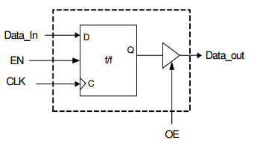
Example : Flip-flop with a tristate output
module tri_DFF (CLK, EN, OE, Data_In, Data_Out );
input CLK, EN, OE, Data_in;
output Data_Out ;
reg Temp ;
always @ (posedge CLK)
if (EN) Temp <= Data_In;
assign Data_Out = OE ?Temp :1‘bz ; // tri-state function
endmodule

Slide 11
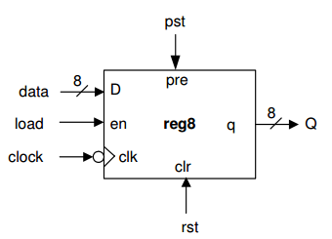
Registers
⋅ Registers are just n-bit (n >1) structures consisting of FFs.
⋅ A common clock is used for each FF in the register.
module reg8 (clock, load, rst, pst, data, Q);
input clock, load ;
input rst, pst ;
input [7:0] data ;
output [7:0] Q ;
reg [7:0] Q ;
always @ (posedge rst or posedge pst or negedge clock)
if (rst) Q <= 0 ;
else if(pst) Q <= 1 ;
else if (load) Q <= data ;
endmodule

Slide 12
Shift registers
module shiftLreg8 (clk, rst, en, ldsh, w, d, q) ;
input[7:0] d ;
Input clk, rst, en, ldsh, w ;
output[7:0] q ;
Integer k;
always @ (negedge rst or posedge clk)
begin
if ( ! rst )
q <= 0 ;
else if ( en )
if ( ldsh )
q <= d;
else
begin
q[0] <= w;
for( k = 1; k <8; k = k+1 )
q[k] <= q[k – 1];
end
end
endmodule

Slide 13
Example 4-bit Universal Shift Register
module univShiftReg (MSBin, LSBin, s1, s0, clock, rst, DataIn, MSBout, LSBout, DataOut);
input MSBin, LSBin, s1, s0 ;
Input clock, rst ;
input [3:0] Datain ;
output MSBout, LSBout ;
output [3:0] Dataout ;
reg[3:0] Dataout ;
assign MSBout = DataOut[3] ;
assign LSBout = DataOut[0] ;
always @ (negedge clock or posedge rst )
begin
if ( rst ) // synchronous reset
DataOut <= 0 ;
else
case ( {s1, s0} )
2’b00 : DataOut <= DataOut ; // hold
2’b01 : DataOut <= { MSBin,DataOut[3:1] } ; // shift right
2’b10 : DataOut <= { DataOut[2:0], LSBin } ; // shift left
2’b11 : DataOut <= DataIn ; // parallel load
endcase
end
endmodule

Slide 14
Exercise:
⋅ Sketch the iobd of this universal shift register
⋅ Obtain its functional block diagram in terms of FFs and the associated glue logic.
Synchronous Counters
Example : A 5-bit up-counter with a parallel load
module upcount5 ( data, Q, clk, rst, ld, inc) ;
input [4:0] data ;
output[4:0] Q ;
input clk, rst ;
input ld, inc ;
reg[4:0] Q ;
always @( posedge rst or posedge clk )
if( rst ) Q <= 0 ;
else if ( ld ) Q <= data ;
else if ( inc ) Q <= Q + 1;
endmodule

Slide 15
Exercise: Provide the I/O block diagram, and derive the operations
table for this counter.
module U_D_counter ( data, count, clk, rst, dir ) ;
input [7:0] data ;
output[7:0] count ;
input clk, rst ;
input [1:0] dir ;
reg[7:0] count ;
always @( negedge rst or negedge clk )
if( rst == 0 ) count <= 8’b00000000 ;
else if (dir == 2’b00 || dir == 2’b11) count <= count ;
else if ( dir == 2’b01 ) count <= count + 1;
else if ( dir == 2’b10 ) count <= count -1;
endmodule
Example:
explain the counter

Slide 16
Example : Derive the circuit synthesized from this Verilog code fragment.
module circuit (S1, CLK, A, B, C, S3, S2, OU) ;
input S1, CLK ;
input [7:0] A, B, C, S3 ;
output [7:0] S2, OU ;
reg[7:0] S2, OU ;
wire[5:0] TEMP1, TEMP2 ; // internal signals
always @ (posedge CLK)
if( S1 )
if(TEMP1 < 8) S2 <= A + B;
else S2 <= C;
always @ (TEMP2 or TEMP1 or S3 or A)
if (TEMP2 >TEMP1) OU <= S3 + A;
...
endmodule

Slide 17
Finite State Machine (FSM)
⋅ A circuit type with memory.
⋅ Usually as datapath controller unit.
⋅ Via algorithmic state machine (ASM) flowchart, an FSM is readily modeled in HDL.
⋅ There are two basic models of FSMs: Moore and Mealy.
⋅ In a Mealy machine, the next state (NS) and the outputs depend on both the present state (PS) and the inputs.
⋅ The NS of a Moore machine depends on the PS and the inputs, but
the outputs depend on only the PS.
⋅ All FSMs have the general feedback structure.
⋅ We will deal only with synchronous FSMs, hence the state
transitions of the machine are synchronized by the active edge of a
common clock. In this case, the state register is consisted of edge triggered flip-flops.

Slide 18
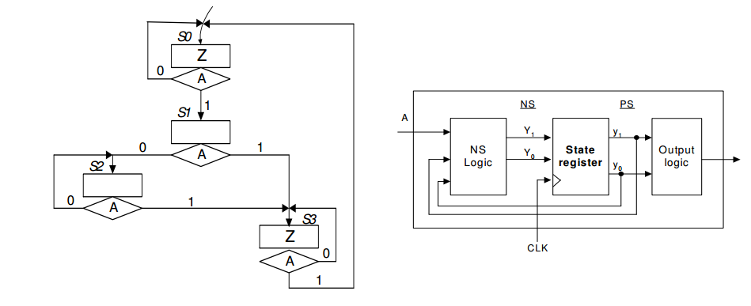
Example : Verilog Modeling of an FSM (version A coding).

Slide 19
module FSM1 ( A, CLK, reset, Z );
input A, CLK, reset ;
outputZ ;
reg [1:0] y, Y ;
parameter [1:0] S0 = 2’b00, S1 = 2’b01, S2 = 2’b10, S3 = 2’b11;
// NS logic module:
always @ (A or y)
case ( y)
S0 : if( A ) Y = S1; elseY = S0;
S1 : if( A ) Y = S3; elseY = S2;
S2 : if( A ) Y = S3; elseY = S2;
S3 : if( A ) Y = S0; elseY = S3;
endcase
// state register module:
always @ ( negedgereset or posedgeCLK )
if(!reset ) y <= S0 ;
elsey <= Y ;
// define the Output Logic:
assign Z = ( y == S0 ) | (y == S3) ;
endmodule

Slide 20
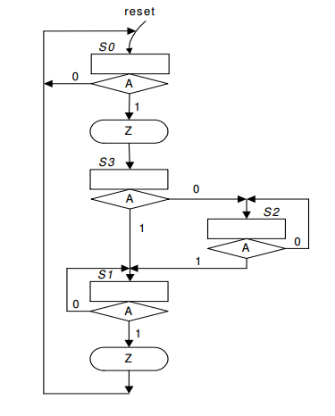
Example : Verilog Modeling of FSM (version B coding).

Slide 21
module FSM2 ( A, CLK, reset, Z );
input A, CLK, reset ;
output Z ;
reg [1:0] y, Y ;
parameter [1:0] S0 = 0, S1 = 1, S2 =2, S3=3;
// define STATE_REG:
always @(negedge reset or negedge CLK)
if( reset == 0 ) y <= A ;
else y <= Y ;
// define NS_OUTPUT and OUTPUT LOGIC:
always @( y or A )
begin
case( y )
S0 : if (A )begin Y = S3 ; Z = 1; end
else begin Y = S0 ; Z = 0; end
S1 : if( A )begin Y = S0 ; Z = 1; end
else begin Y = S1 ; Z = 0; end
S2 : if ( A )begin Y = S1 ; Z = 0; end
else begin Y = S2 ; Z = 0; end
S3 : if ( A )begin Y = S1 ; Z = 0; end
else begin Y = S2 ; Z = 0; end
endcase
end
endmodule

